Slide 1
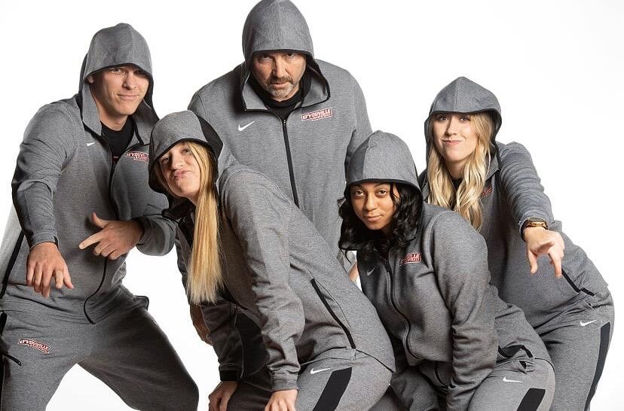
Log in to your computer and your Google Account and wait for further instructions

Slide 2
Formatting Google Docs
Notes & Videos for Week 6 - 7 Facts About St. Patrick Format Assignment

Slide 3

OBJECTIVES:
Students will edit a Google Doc using the following formatting tools:
Format Painter
Font Type
Font Size
Bold & Italic
Text Color
Alignment
Line Spacing
File Menu- Page Setup
Insert Menu - Break - Page Break

Slide 4
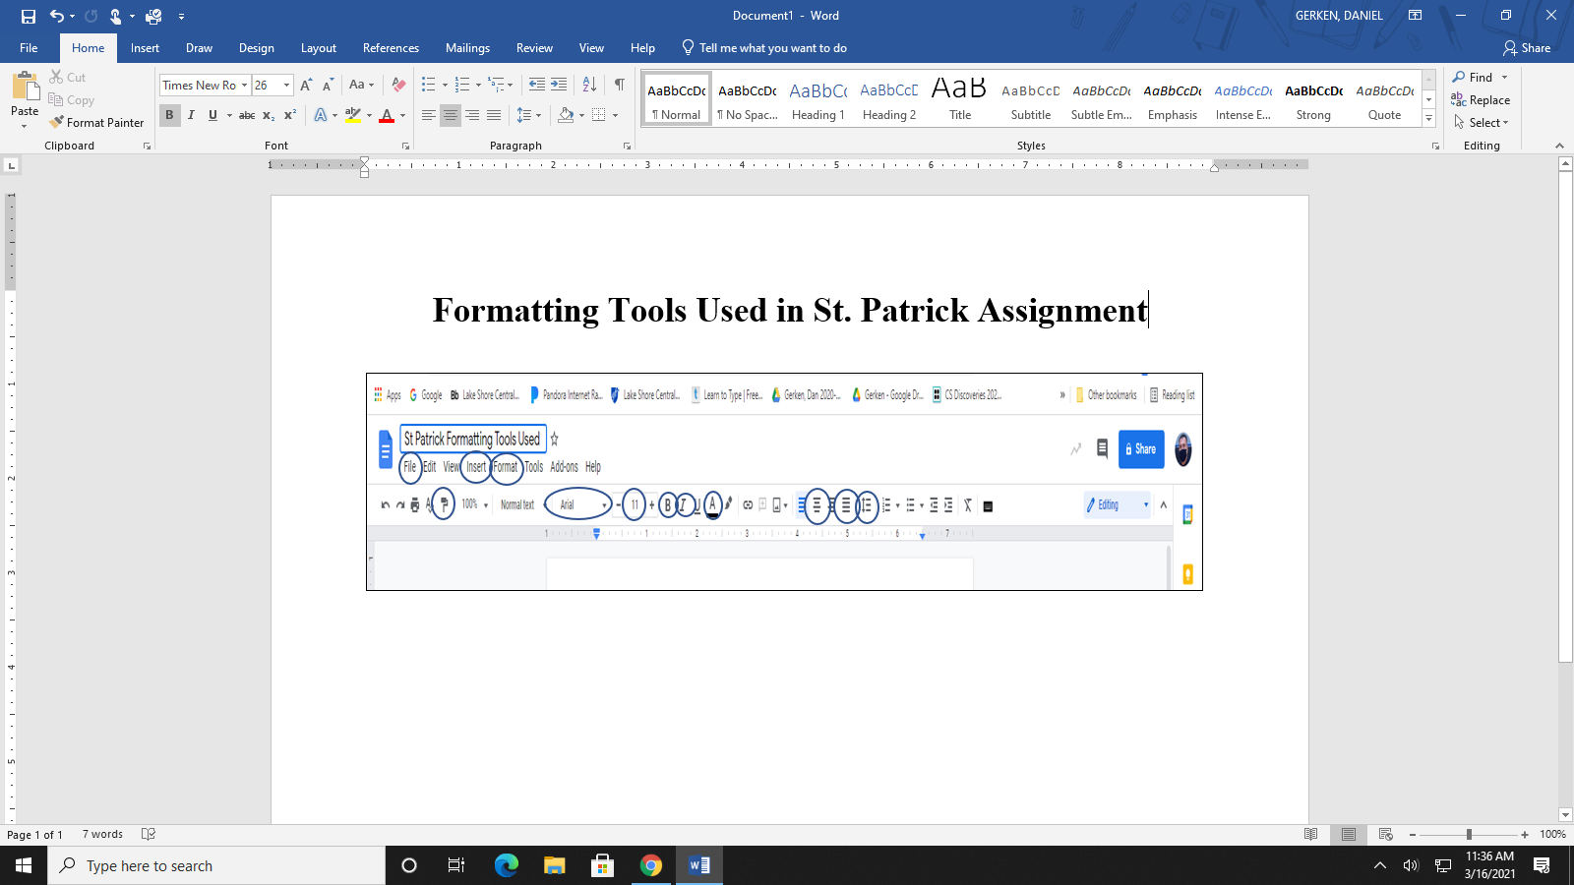

Slide 5
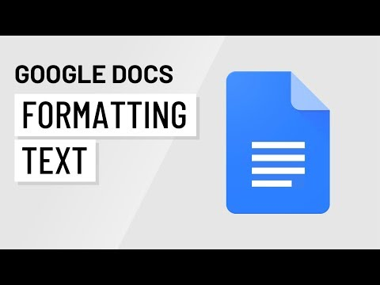

Slide 6
